Slide 1
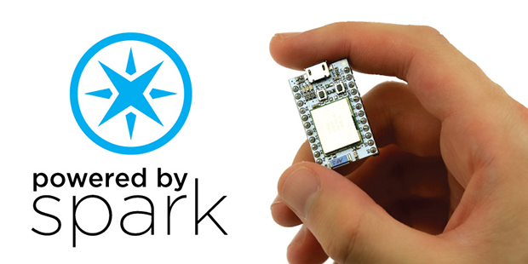
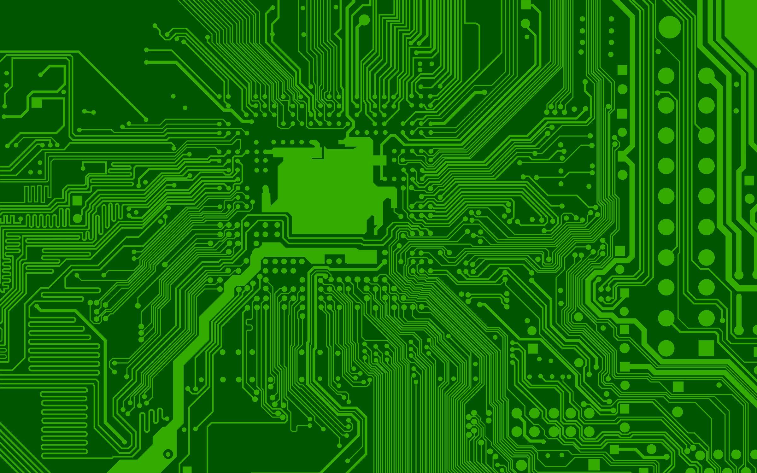
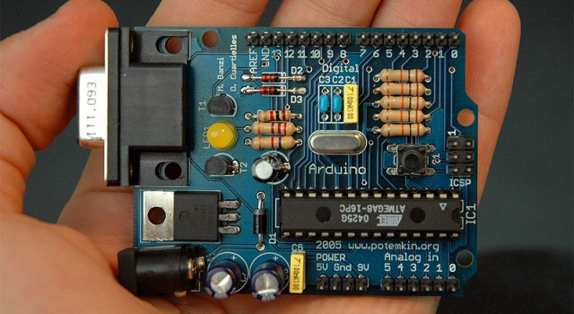
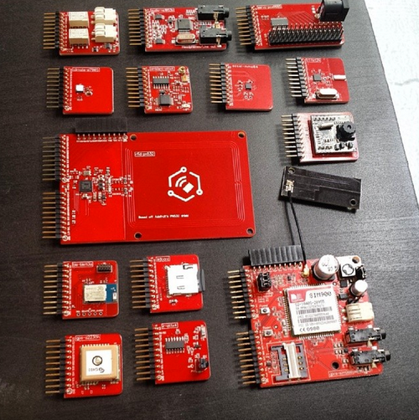
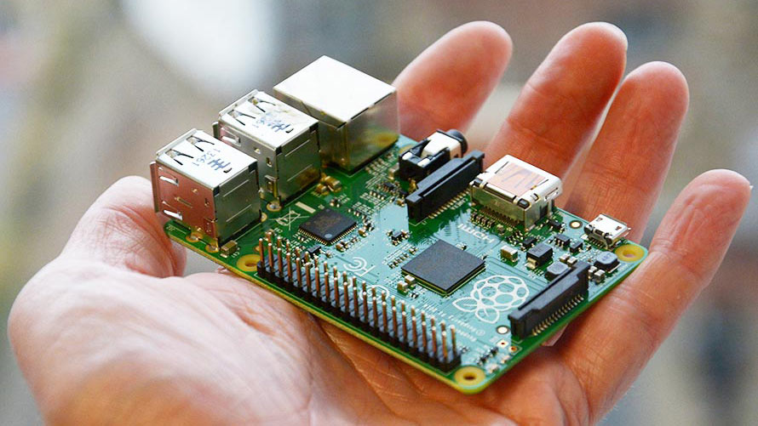
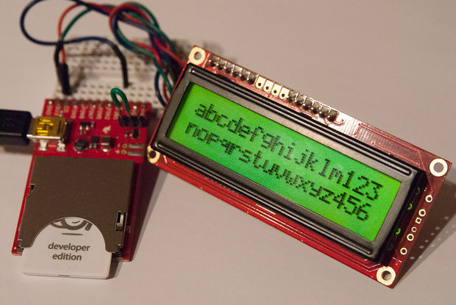
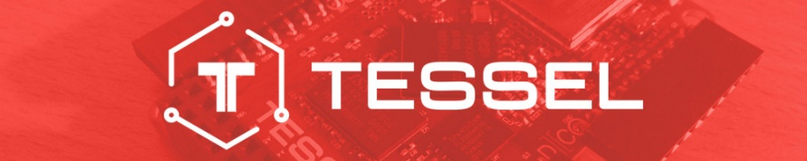



Hardware

Slide 2
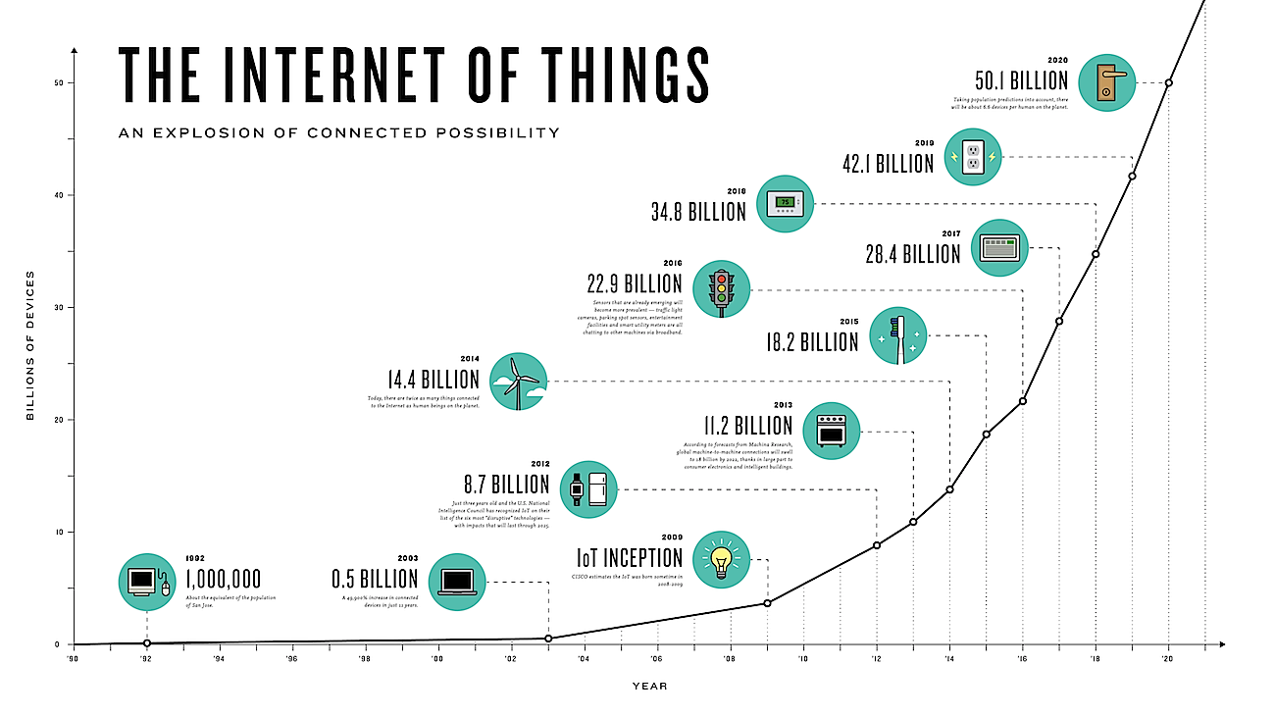
https://www.youtube.com/watch?v=mzy84Vb_Gxk

Slide 3
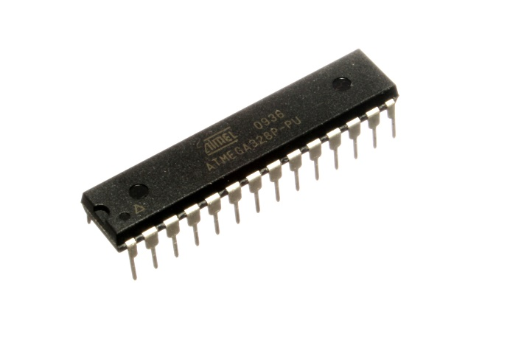
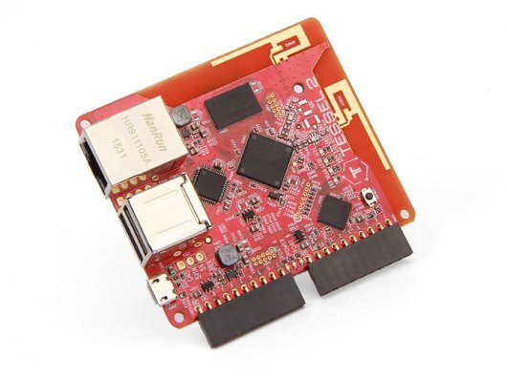

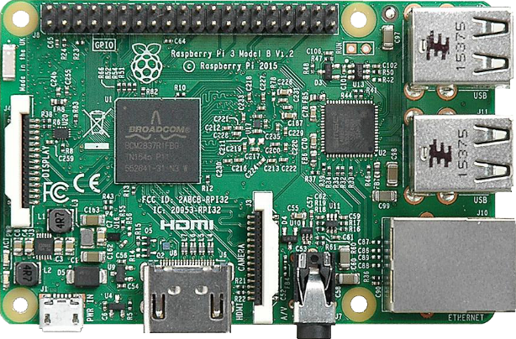
The Microcontroller Spectrum
Application Specific
Prototype
General Purpose
Atmega328
Requires approx. 10% of Arduino hardware to function
Arduino compatible programming
Arduino
Atmega328
All support hardware included
USB programming
Power regulation
Pins “Broken out”
C-like programming language
Tessel
RISC based
Includes WIFI and Ethernet
Javascript based (NodeJS)
Pins “Broken out”
Raspbery Pi
A fully functioning computer(!)
Pins “broken out”

Slide 4

Arduino
“The immediate precursor to the Arduino was a custom-made Wiring microcontroller created by the artist/ designer Hernando Barragan in 2004 for his masters thesis (at Institute Design Institute Ivrea), intended for use by a “non-technical audience” of “artists, designers, and architects”
“The Arduino incorporated the following characteristics: a programming environment based on Processing language (a programming language conceived by Ben Fry and Casey Reas, also conceived for artists/ designers), the ability to program the board via a standard USB connection, and a low price point (starting at about $35 USD)”
http://www.kenleung.ca/portfolio/arduino-a-brief-history-3/

Slide 5
Arduino
Arduino is
A bootloader
An IDE
A programming language (But it’s basically “just” C)
A device
Development environment is free
Thousands of libraries
Started as “Wiring” and “Processing”
What existed before?
Atmel studio
Now “free”, previously expensive
There is still a paid for version
Price is a mystery, purchasing is a mystery “Contact them”

Slide 6
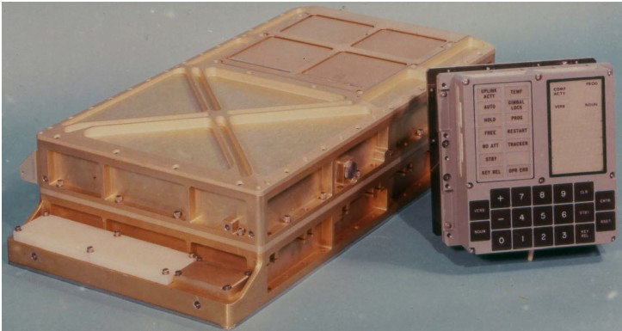
Arduino UNO
Flash memory | 32 KB | Storage for code
RAM | 2 KB | Storage for variables
EEPROM | 1 KB | Long term storage
Clock speed | 16 Mhz | Equivalent to a 1980’s CPU
Power consumption | 0.29 W
Weight | 25 g
Apollo Guidance Computer (1966)
Flash memory | 0 KB
RAM | 4 KB | Storage for variables
EEPROM | 74 KB | Storage for code
Clock speed | 2 Mhz
Power consumption | 55 W
Weight | 32 Kg

Slide 7
What is an Arduino for?
Power and programming over USB
Arduino’s, or microcontrollers in general, are a platform for prototyping electronics. They allow you to read from sensors, control actuators and screens, and communicate with computers, all through code.
Most projects require very little knowledge of electronics.
Digital Input/Output read and write Low or High signals.
Low = 0V = GND
High = 5V
Uses:
Writing to displays
Serial input/output
Analog Input/Output pins read and write any voltage in the range 0V to 5V. Uses:
Reading sensors
Setting servo motors

Slide 8
2001: Processing Programming Language
2004: Wiring
2005: Arduino
2014: ESP8266
$2 Wifi microcontroller(!)

Slide 9
Tessel
Tessel is:
A device
A software framework
Tessel runs NodeJS – Javascript
Any package on NPM runs on tessel
Launched by a Boston based startup in 2013

Slide 10
Tessel 2
Flash memory | 32 MB | Storage for code
RAM | 64 MB | Storage for variables
EEPROM | 1 KB | Long term storage
Clock speed | 580 Mhz
Power consumption | 0.85 W
Weight | 68 g
Atmel coprocessor | 48 Mhz | Realtime microcontroller
Apollo Guidance Computer (1966)
Flash memory | 0 KB
RAM | 4 KB | Storage for variables
EEPROM | 74 KB | Storage for code
Clock speed | 2 Mhz
Power consumption | 55 W
Weight | 32 Kg

Slide 11
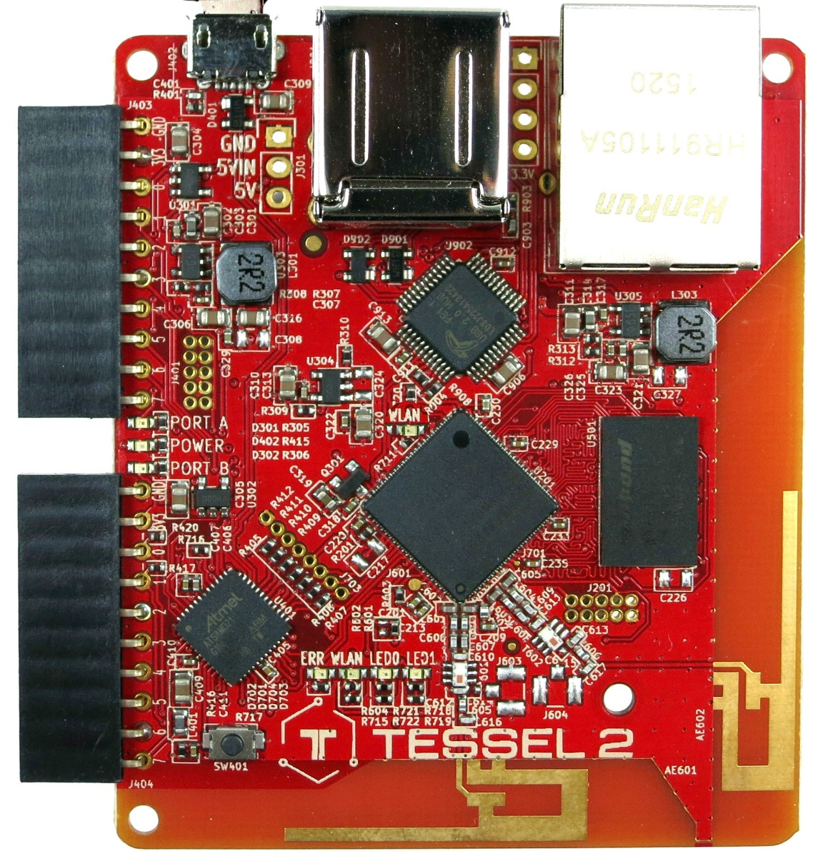
Tessel
MicroUSB and Regular USB for power and/or programming
Ethernet for network, can also provide power
Tessel can be programmed over USB, Ethernet, or WiFi!
IO Pins – See next slide
WiFi Antenna

Slide 12
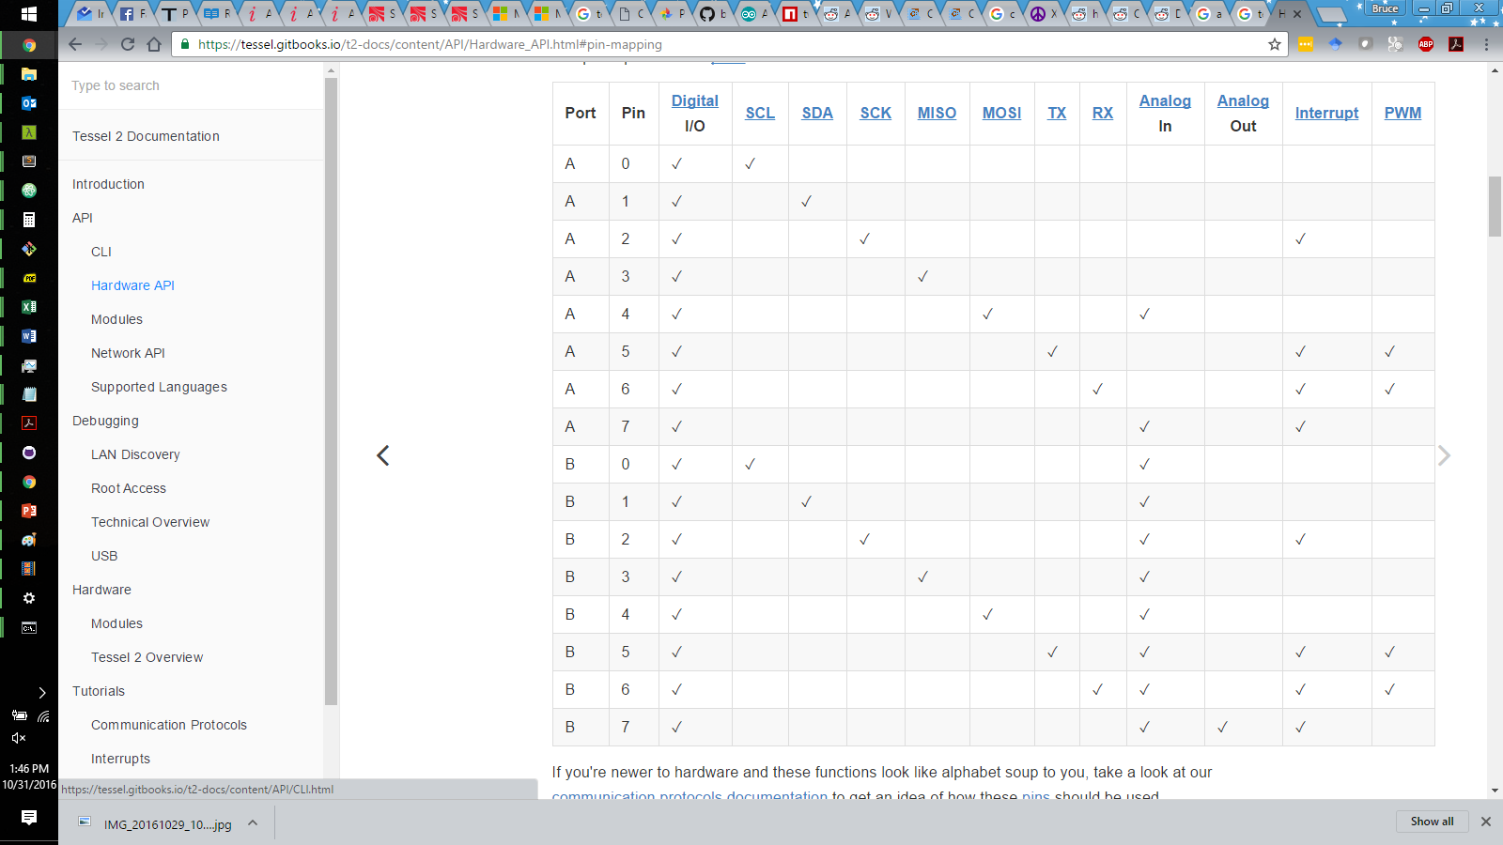
Tessel Pin Map
SCL/SDA/SCK; MISO/MOSI; Tx/Rx: Serial communication, allowing microcontrollers to talk directly to each other, or to a computer.
Interrupt: If this pin is set (externally) to high, it will trigger an interrupt callback in the microcontroller, which will run instead of the already running code
PWM: Pulse Width Modulation, allows you to write a value 0-255 to a pin

Slide 13
Why Tessel?
WiFi + Javascript

Slide 14
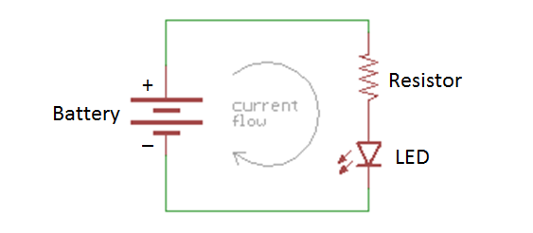
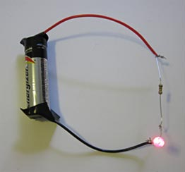
Example: LEDs
The resistor provides resistance which changes the current (V=IR)
The Battery provides current at fixed voltage
The brightness of the LED is determined by how much current is supplied

Slide 15
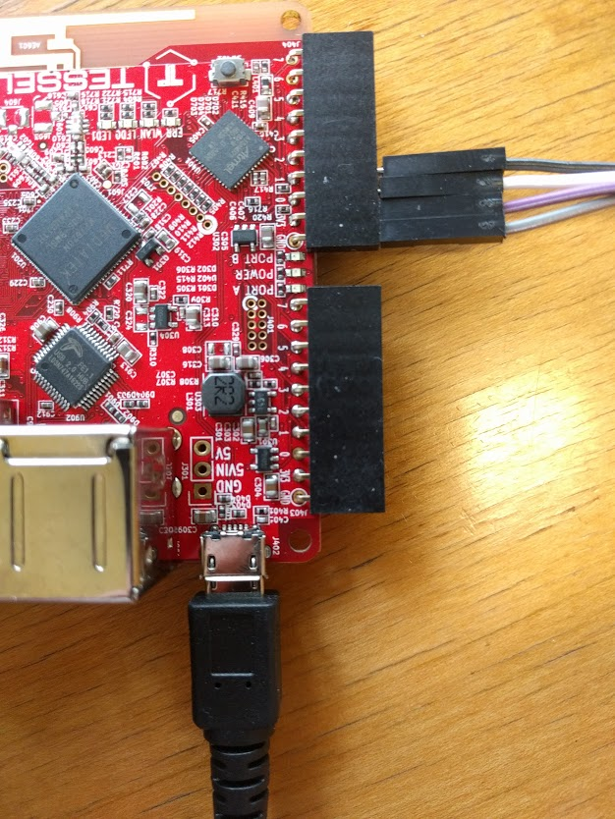
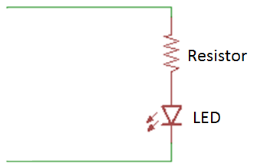
Example: LEDs
In the initial example, the battery simply provides a constant voltage, driving a current in the circuit. If the battery is flat, the voltage (or Potential) at + and - is 0V, so no current flows. For current flow the potential at + must by higher than at –.
We can exploit this to switch an LED on/off using pins on a microcontroller.

Slide 16
Example: LEDs
Pins, marked here as 0, 1, 2, etc, can be set in code to be high or low.
High = potential of 3.3V
Low = potential of 0V
GND in this case is a potential of 0V

Slide 17
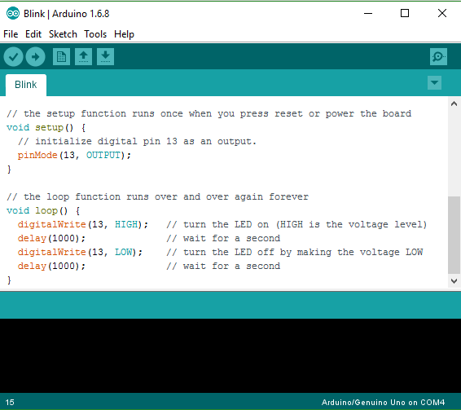
Arduino

Slide 18
Arduino

Slide 19
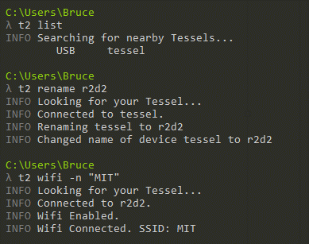
Tessel Setup
Open a terminal and run
npm install –g t2-cli
Check it’s working
t2 list
Name your tessel
t2 rename <name>
Connect to WiFi
T2 wifi –n “MIT”
If MIT doesn’t work, try “MIT GUEST”

Slide 20
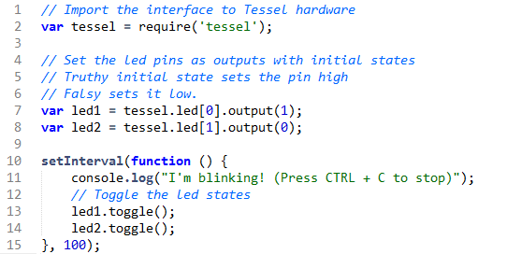
Blink on Tessel

Slide 21
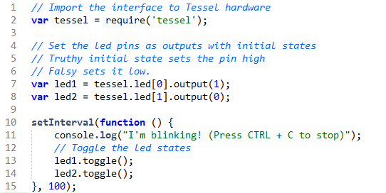
Blink on Tessel
t2 run index.js

Slide 22
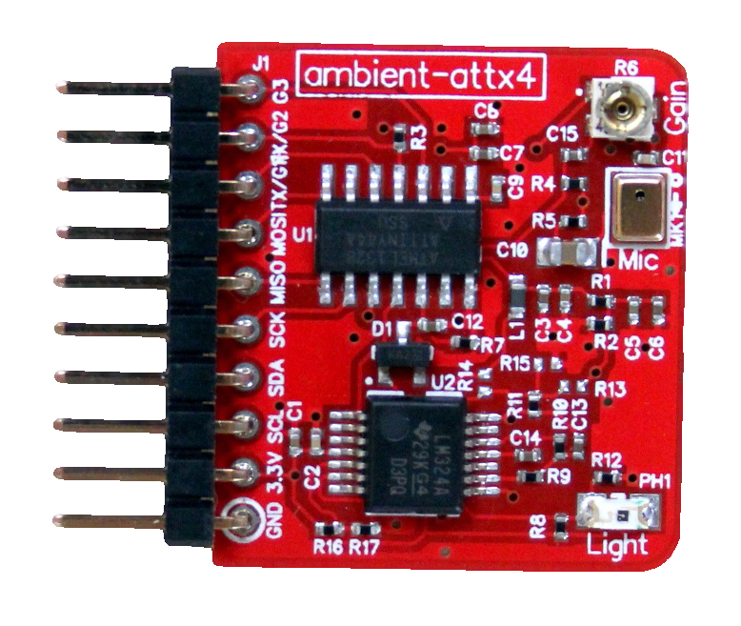
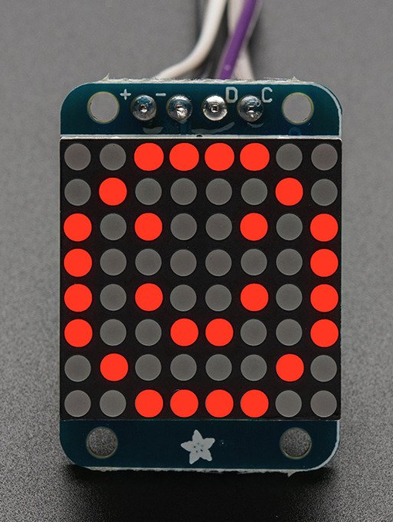
Components
Ambient
LED Matrix
Light sensor
Sound sensor
Designed and manufactured by for Tessel
LED Matrix
Support Hardware
Serial interface
Control 64 LED’s with only 4 wires

Slide 23
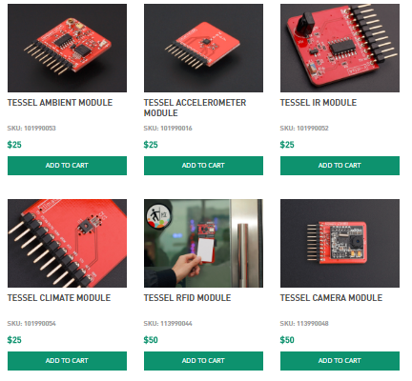
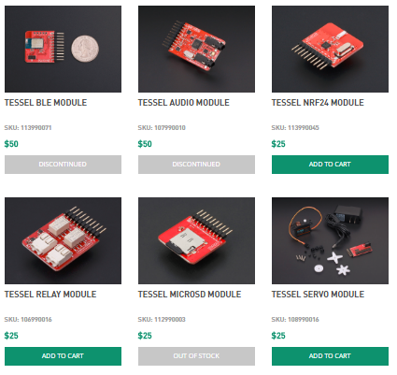
Tessel Modules - Full List (https://tessel.io/modules)

Slide 24
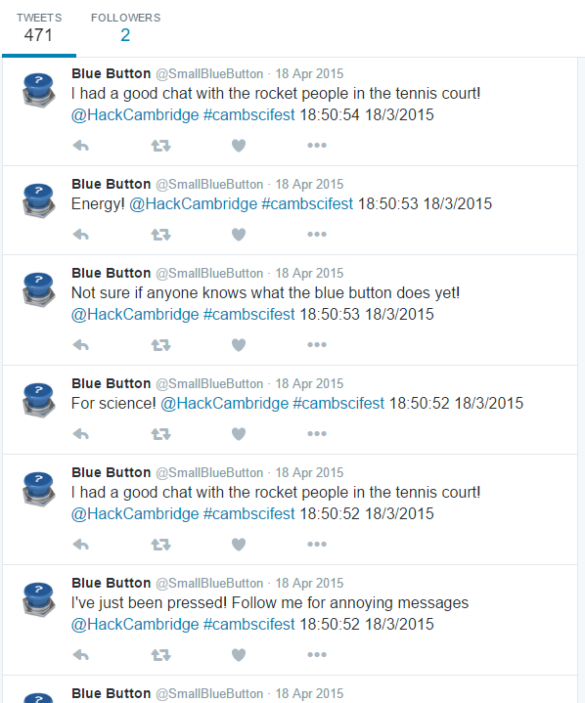
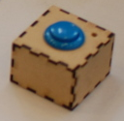
Case Study: The Blue Button
1 Button. 1 Electric Imp
Uses: Various

Slide 25
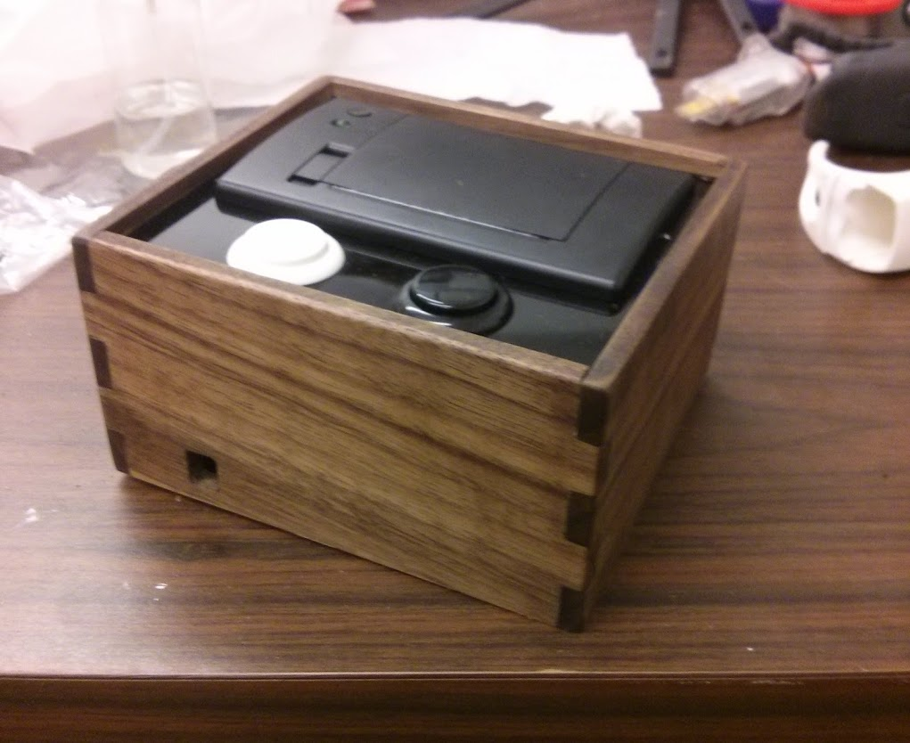
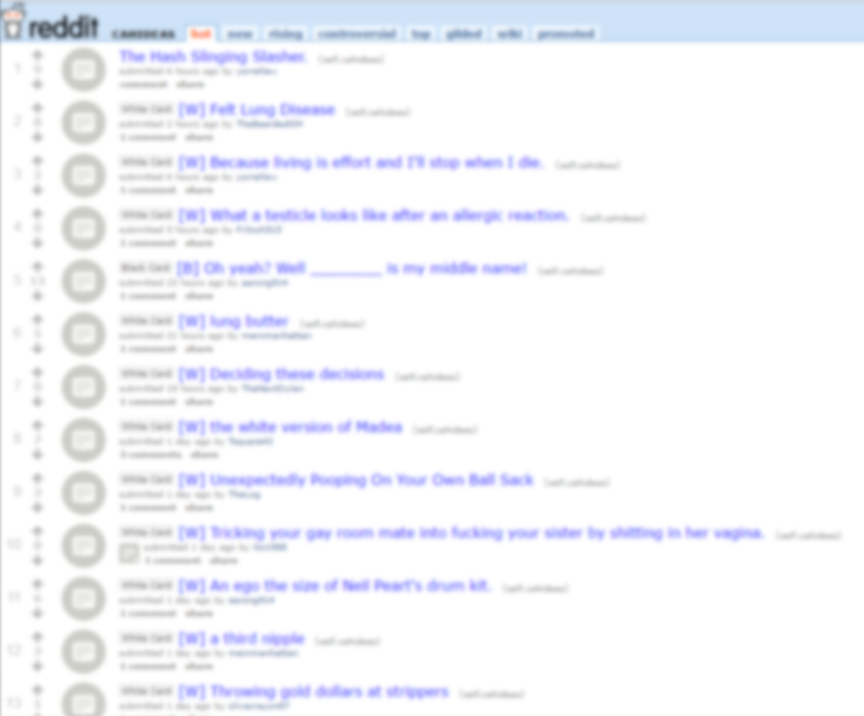
Case Study: Cards Against Humanity Printer
Electric Imp for WiFi
Thermal Printer – Receipt printer
Prints random cards from reddit
NOT SAFE FOR WORK
Reddit.com/r/cahideas

Slide 26
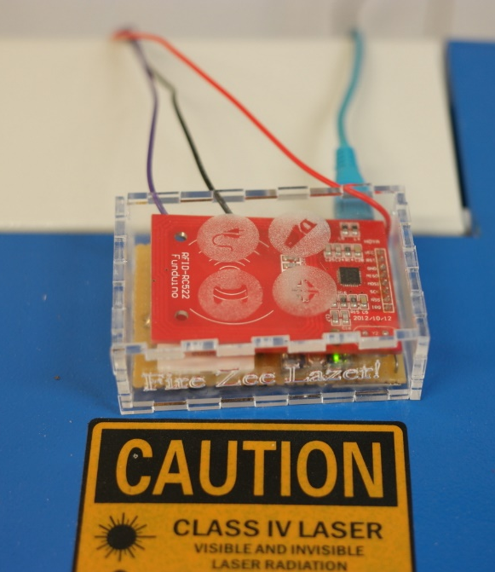
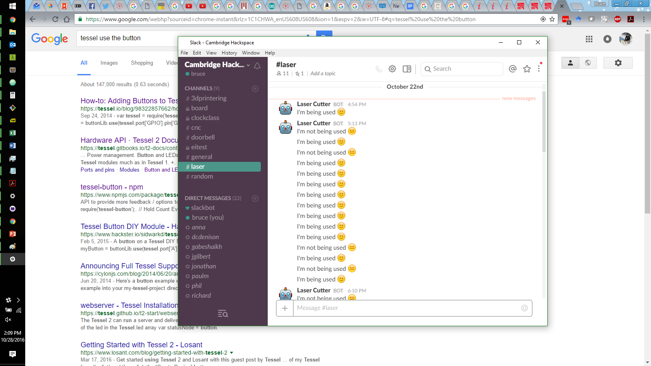
Case Study: Toolpass
System to manage access to our laser cutter
Users log in using their Charlie Card
Logs member usage for billing
Reports activity on slack
Server
User auth
Toolpass
Switch on/off
Laser Cutter
Slack Messages
Charlie Card,
Laser usage
Laser Fired

Slide 27
Case Study: Toolpass

Slide 28
Hardware examples
https://www.ted.com/talks/neil_harbisson_i_listen_to_color
http://www.bbc.com/news/technology-37775605

Slide 29
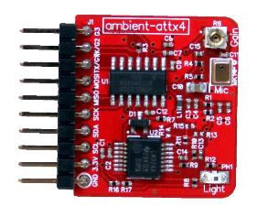
Tessel Ambient Module
index.js
var tessel = require('tessel');
var ambientlib = require('ambient-attx4');
var ambient = ambientlib.use(tessel.port['A']);
ambient.on('ready', function () {
// Get points of light and sound data.
setInterval( function () {
ambient.getLightLevel( function(err, lightdata) {
if (err) throw err;
ambient.getSoundLevel( function(err, sounddata) {
if (err) throw err;
console.log("Light level:", lightdata.toFixed(8), " ", "Sound Level:", sounddata.toFixed(8));
});
});
}, 500); // The readings will happen every .5 seconds
});
package.json
{
"name": "hello",
"version": "0.0.0",
"description": "Tessel project",
"main": "index.js",
"dependencies" :
{
"ambient-attx4" : "0.2.11",
"mqtt" : "2.0.1",
"backpack-ht16k33" : "0.2.1"
}
}

Slide 30

Send a tweet!
index.js
var twitter = require('twitter');
// authentication for https://twitter.com/course1_125
var twit = new twitter({
consumer_key: 'sCPDZyS0yJRMrdOZ8T2vXFC1R',
consumer_secret: 'VYe5JX7G0nVWsG4wouyONviHYIdPLZJ79w1wFIv8jhUdEAdBaK',
access_token_key: '783748853409406976-1mrcIng9HwtyAxRaxaUnPHjlRoYuWQ6',
access_token_secret: 'lIuWaXEZRc4xY9GgPhkrtYPCcvKhIJz1YDwmtMKiY82hr'
});
twit.post('statuses/update', {status: “Your message here!”}, function(error, tweet, response) {
package.json
{
"name": "hello",
"version": "0.0.0",
"description": "Tessel project",
"main": "index.js",
"dependencies" :
{
"ambient-attx4" : "0.2.11",
"mqtt" : "2.0.1",
"backpack-ht16k33" : "0.2.1“,
“twitter" : “1.4.0"
}
}

Slide 31
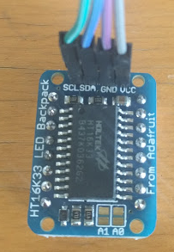
Connecting the LED Matrix
LED Matrix | SCL | SDA | GND | VCC
Tessel | A/B 0 | A/B 1 | GND | 3V3
Which pins to connect

Slide 32
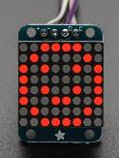
Tessel LED Matrix
package.json
Index.js
{
"name": "hello",
"version": "0.0.0",
"description": "Tessel project",
"main": "index.js",
"dependencies" :
{
"ambient-attx4" : "0.2.11",
"mqtt" : "2.0.1",
"backpack-ht16k33" : "0.2.1"
}
}
var tessel = require("tessel");
var backpack = require('backpack-ht16k33').use(tessel.port['B']);
backpack.on('ready', function() {
backpack.clear();
setInterval(function() {},500); // Keep the tessel alive
//backpack.writeBitmap(smile);
backpack.animate(frames,500);
//backpack.scroll(smile,500);
});
var frames = [smile, straight, frown];
// Add bitmaps from next slide

Slide 33
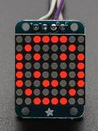
Tessel LED Matrix
var smile = [
[0,0,1,1,1,1,0,0],
[0,1,0,0,0,0,1,0],
[1,0,1,0,0,1,0,1],
[1,0,0,0,0,0,0,1],
[1,0,1,0,0,1,0,1],
[1,0,0,1,1,0,0,1],
[0,1,0,0,0,0,1,0],
[0,0,1,1,1,1,0,0],
];
var straight = [
[0,0,1,1,1,1,0,0],
[0,1,0,0,0,0,1,0],
[1,0,1,0,0,1,0,1],
[1,0,0,0,0,0,0,1],
[1,0,0,0,0,0,0,1],
[1,0,1,1,1,1,0,1],
[0,1,0,0,0,0,1,0],
[0,0,1,1,1,1,0,0],
];
var frown = [
[0,0,1,1,1,1,0,0],
[0,1,0,0,0,0,1,0],
[1,0,1,0,0,1,0,1],
[1,0,0,0,0,0,0,1],
[1,0,0,1,1,0,0,1],
[1,0,1,0,0,1,0,1],
[0,1,0,0,0,0,1,0],
[0,0,1,1,1,1,0,0],
];

